Slide 1


CMR TECHNICAL CAMPUS
UGC AUTONOMOUS
Accredited by NBA & NAAC with ‘A’ Grade
Approved by AICTE,New Delhi and affiliated to JNTU,Hyderabad Kandlakoya (V), Medchal Road, Hyderabad -501401, Telangana
Department of Computer Science and Engineering
Mini Project Review
NETWORK INTRUSION DETECTION USING
SUPERVISED MACHINE LEARNING TECHNIQUE
WITH FEATURE SELECTION
BATCH NO-10
UNDER THE GUIDENCE OF :
Dr .G.Madhukar
(Associate Professor)
PRESENTED BY:
RASNOLA GAYATHRI : 207R1A05N6
VANAPARTHI ARCHANA : 207R1A05P4 KUKKAMALLA DEEPESH : 217R5A0524

Slide 2
Contents
Abstract
Existing System
Disadvantages of Existing System
Proposed System
Advantages of Proposed System
Hardware and software requirements
Novelty of the project
Architecture
Modules
UML diagrams
Conclusion

Slide 3
Abstract
A novel supervised machine learning system is developed to the classify network traffic whether it is malicious or benign.
To find the best model considering detection success rate, combination of supervised learning algorithm and feature selection method have been used.
Through this study, it is found that Artificial Neural Network (ANN) based machine learning with wrapper feature selection outperform support vector machine (SVM) technique while classifying network traffic.
To evaluate the performance, NSL-KDD dataset is used to classify network traffic using SVM and ANN supervised machine learning techniques.
Comparative study shows that the proposed model is efficient than other existing models with respect to intrusion detection success rate.

Slide 4
Existing system
There are many real life applications we are using today offered by machine learning. It seems that machine learning will rule the world in coming days.
Hence we came out into a hypothesis that the challenge of identifying new attacks or zero day attacks facing by the technology enabled organizations today can be overcome using machine learning techniques.
Here we developed a supervised machine learning model that can classify unseen network traffic based on what is learnt from the seen traffic.
We used both SVM and ANN learning algorithm to find the classifier with higher accuracy and success rate. This paper is organized as follows: overview of the system model and design is explained in section II, the system experimental analysis

Slide 5
Disadvantages of existing system
In the given existing system they used supervised machine algorithms to find the network traffic in a given dataset due to this the classifier does not work well for limited dataset.
the feature selection method is not good, irrelevent and redundant features are present
Less accuracy
Less efficiency

Slide 6
Proposed System
Feature selection is an important part in machine learning to reduce data dimensionality and extensive research carried out for a reliable feature selection method. For feature selection filter method and wrapper method have been used.
In filter method, features are selected on the basis of their scores in various statistical tests that measure the relevance of features by their correlation with dependent variable or outcome variable. Wrapper method finds a subset of features by measuring the usefulness of a subset of feature with the dependent variable.
Hence filter methods are independent of any machine learning algorithm whereas in wrapper method the best feature subset selected depends on the machine learning algorithm used to train the model.
In wrapper method a subset evaluator uses all possible subsets and then uses a classification algorithm to convince classifiers from the features in each subset. The classifier consider the subset of feature with which the classification algorithm performs the best

Slide 7
Advantages of Proposed System
There are several advantages of using a supervised machine learning technique for detecting network intrusion. One advantage is that it is more accurate than without feature selection. For example, the technique can detect network intrusion at a significantly lower false positive rate (FGR) of only 0.1%. This is because the feature selection affects the number of neurons in the network, not the size of the network. With only a small number of neurons, the false positive rate is also low.
Another advantage is that the technique is more efficient. With feature selection, the number of neurons in the network increases gradually as the number of features

Slide 8
Hardware Requirements
For Developing The Application The Following Are The Hardware Requirements:
SYSTEM : i3 OR ABOVE
RAM : 4GB
HARD DISK : 40GB
Software Requirements
For Developing The Application The Following Are The Software Requirements:
OPERATING SYSTEM : WINDOWS 8 OR ABOVE
CODING LANGUAGE : PYTHON

Slide 9
Novelty of the project
Supervised machine learning is a technique used to detect network intrusions. The technique is used on a regular basis in many industries, including information technology, advertising, and online marketing. However, the technique has some limitations.
For example, the technique is used on unstructured data, which may be out of the reach of human players. Additionally, the technique is used with in-house algorithms, which can take time to learn and are not as accurate when it comes to network intrusions.
The novelty of the Supervised Machine Learning technique with feature selection is that it uses a specific algorithm that is able to detect.

Slide 10
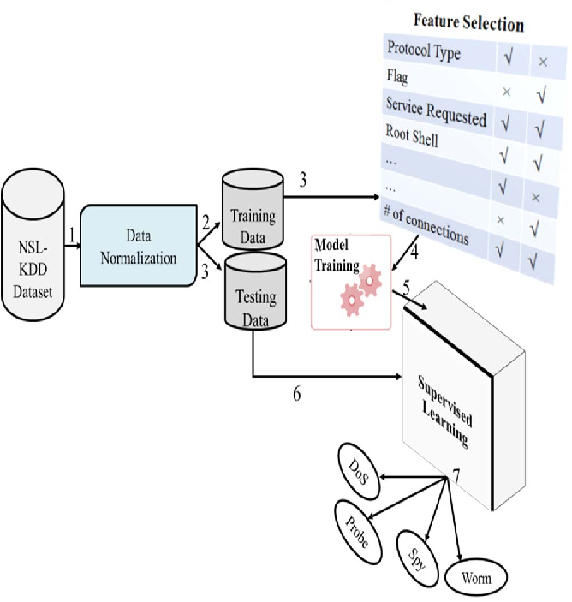
Architecture

Slide 11
Modules
Uploading the NSL and KDD dataset
PreProcess the dataset
Generate Training model
Run SVM Algorithm
Run ANN Algorithm
Upload Testdata and detect attack
Accuracy Graph

Slide 12
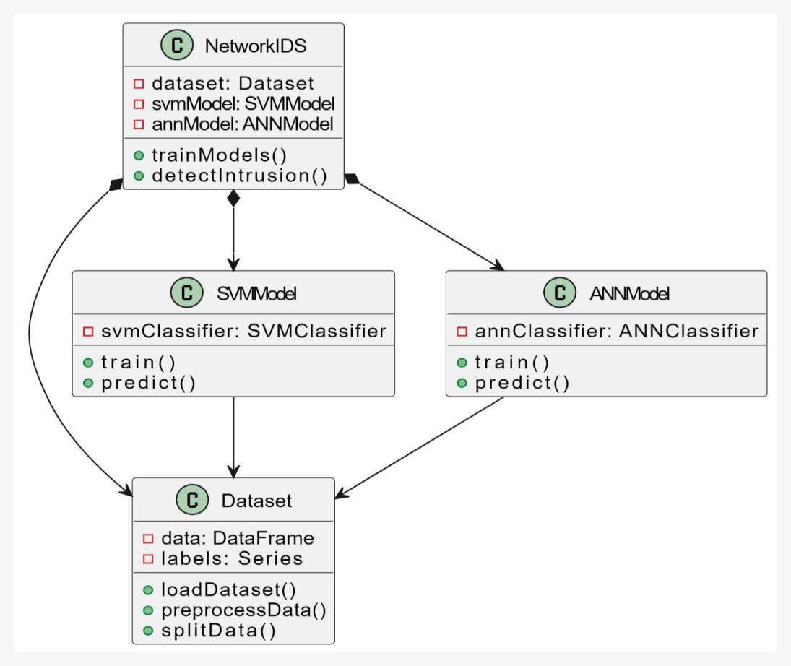
UML DIAGRAMS Class diagram:

Slide 13
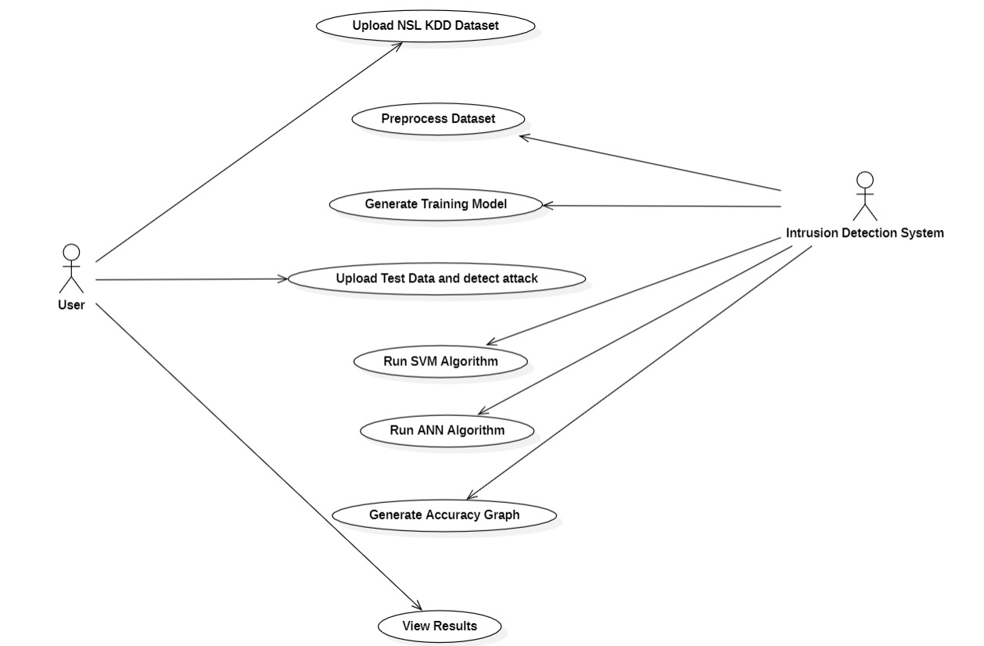
Usecase diagram

Slide 14
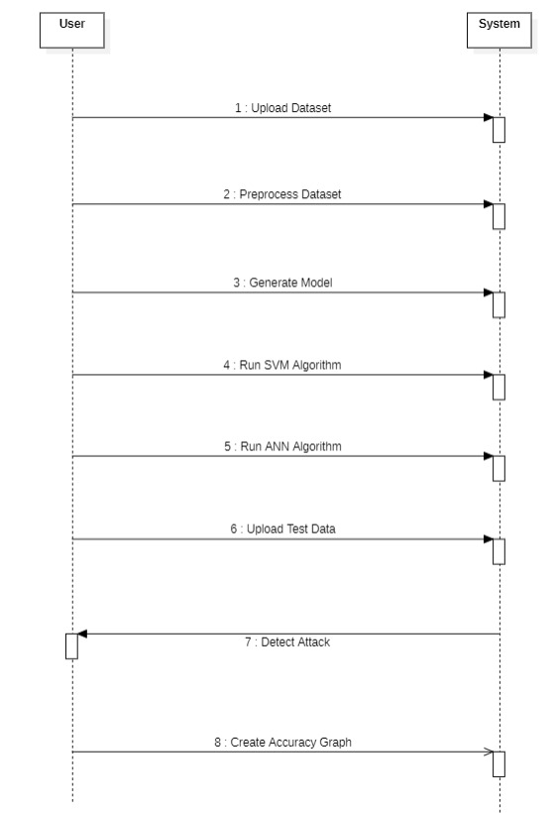
Sequence diagram

Slide 15
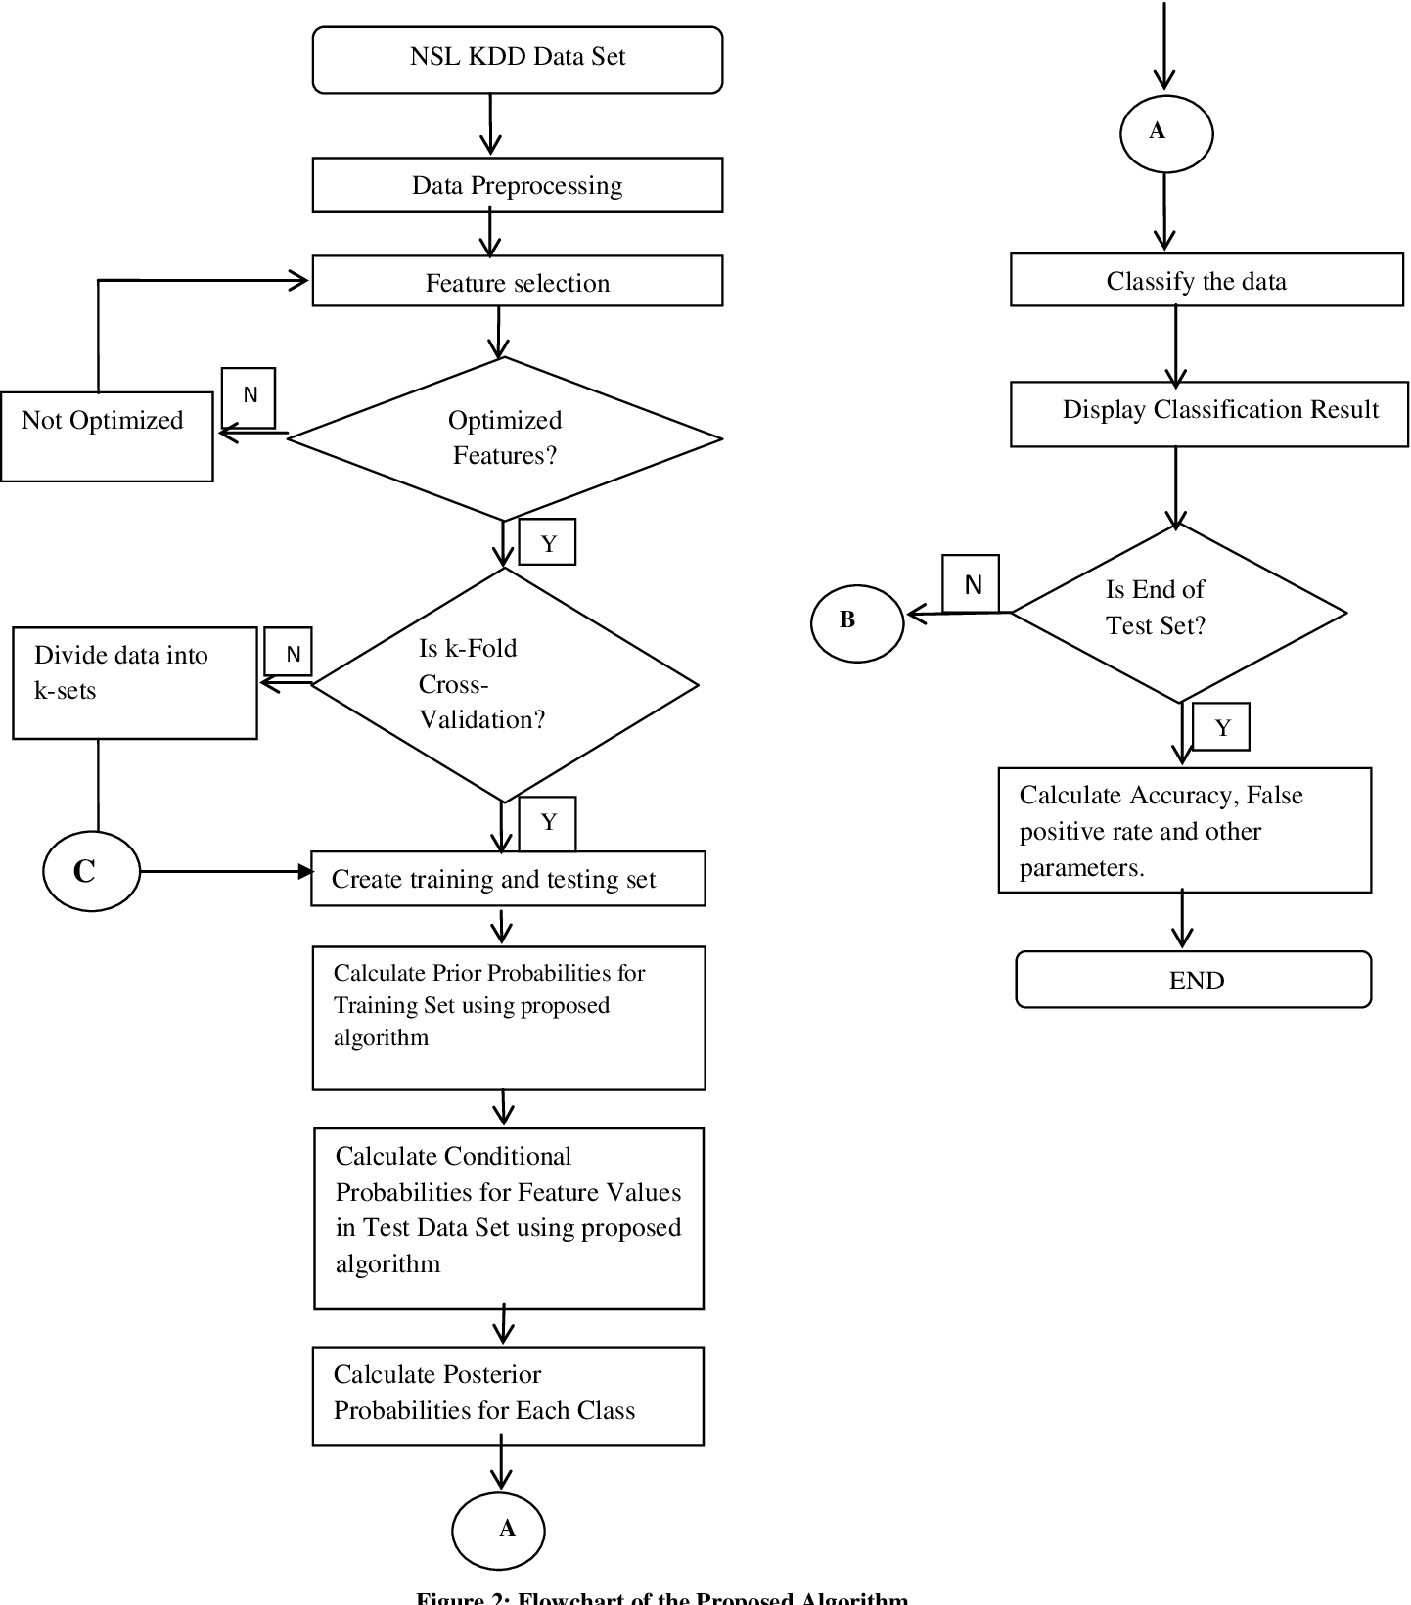
Activity diagram

Slide 16
Sample code
from tkinter import messagebox
from tkinter import *
from tkinter import simpledialog
import tkinter
from tkinter import filedialog
from imutils import paths
import matplotlib.pyplot as plt
import numpy as np
from tkinter.filedialog import askopenfilename
import numpy as np
import pandas as pd
from sklearn import *
from sklearn.model_selection import train_test_split
from sklearn import svm
from sklearn.metrics import accuracy_score

Slide 17
def runSVM():
text.delete('1.0', END)
global svm_acc
global classifier
global X, Y, X_train, X_test, y_train, y_test
total = X_train.shape[1];
#X_train1 = SelectKBest(chi2,15).fit_transform(X_train, y_train)
#X_test1 = SelectKBest(chi2,15).fit_transform(X_test,y_test)
text.insert(END,"Total Features : "+str(total)+"\n")
text.insert(END,"Features set reduce after applying features selection concept : "+str((total - X_train.shape[1]))+"\n\n")
cls = svm.SVC(kernel=‘rbf', class_weight='balanced', probability=True)
cls.fit(X_train, y_train)
text.insert(END,"Prediction Results\n\n")
prediction_data = prediction(X_test, cls)
svm_acc = cal_accuracy(y_test, prediction_data,'SVM Accuracy, Classification Report & Confusion Matrix')
classifier = cls
def runANN():
text.delete('1.0', END)
global ann_acc
global X, Y, X_train, X_test, y_train, y_test
total = X_train.shape[1];
X_train = SelectKBest(chi2,25).fit_transform(X_train, y_train)
X_test = SelectKBest(chi2,25).fit_transform(X_test,y_test)
text.insert(END,"Total Features : "+str(total)+"\n")
text.insert(END,"Features set reduce after applying features selection concept : "+str((total - X_train.shape[1]))+"\n\n")
model = Sequential()

Slide 18
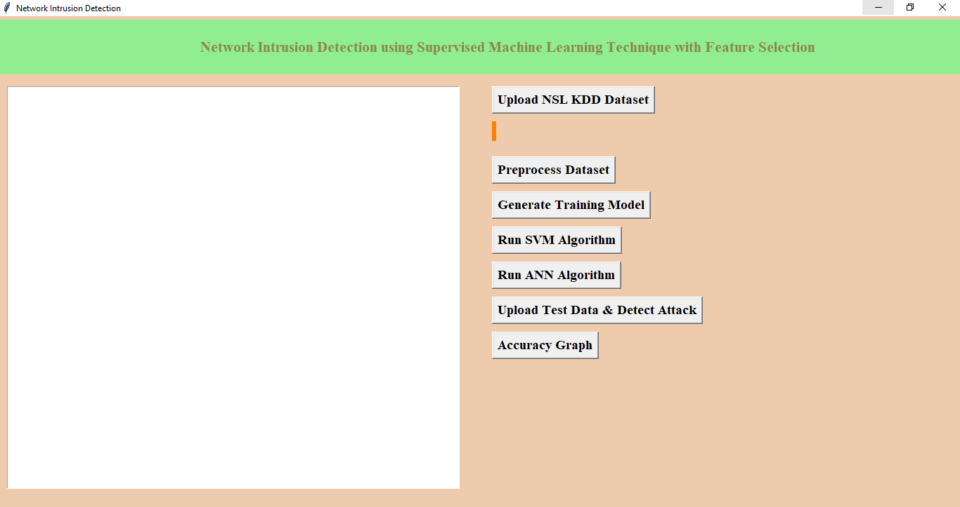
Results
In the above click Shows the contents to execute Network Intrusion Detection Using Supervised Machine Learning Technique with Feature Selection.

Slide 19
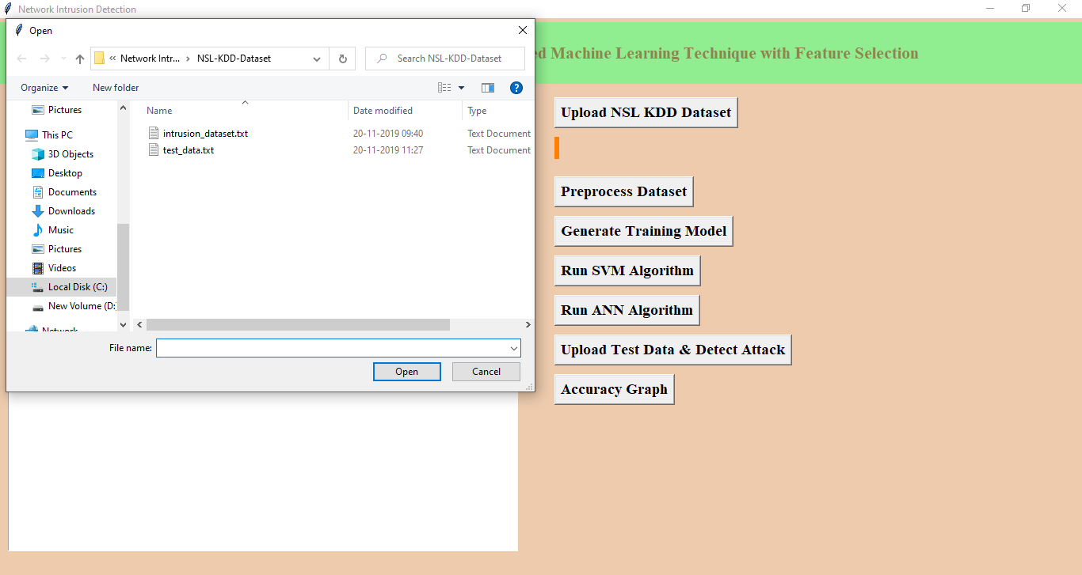
In above screen we are uploading ‘intrusion_dataset.txt’ file, after uploading dataset will get below screen

Slide 20
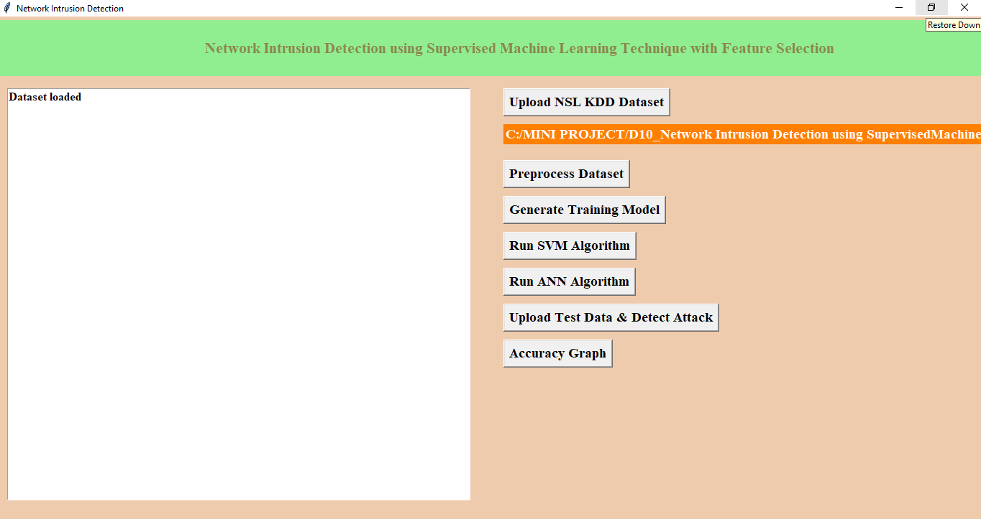
Now click on ‘Pre-process Dataset’ button to clean dataset to remove string values from dataset and to convert attack names to numeric values

Slide 21
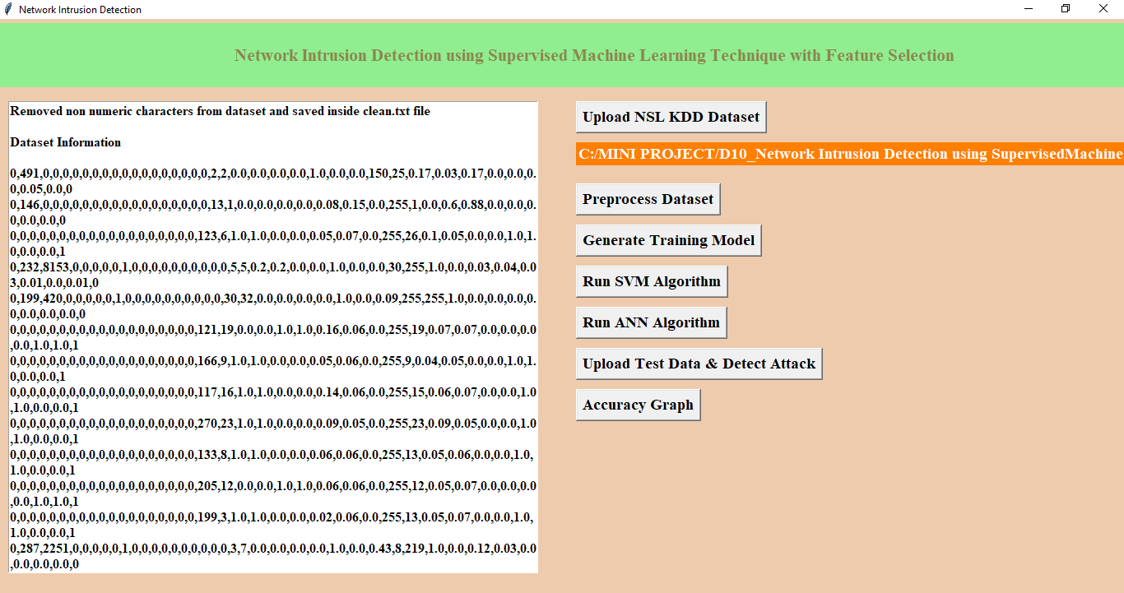
After pre-processing all string values removed and convert string attack names to numeric values such as normal signature contains id 0 and anomaly attack contains signature id 1.
Now click on ‘Generate Training Model’ to split train and test data to generate model for prediction using SVM and ANN

Slide 22
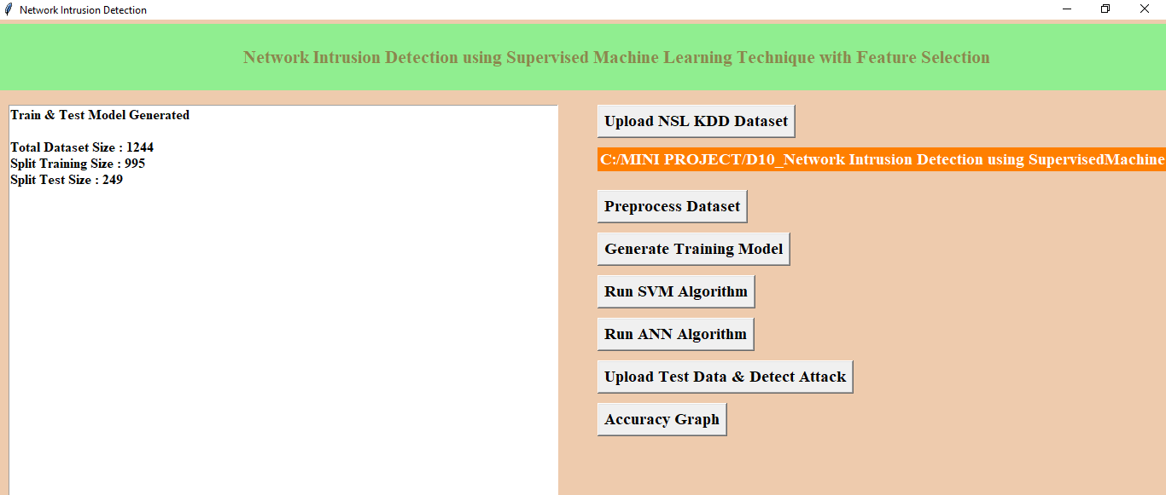
In above screen we can see dataset contains total 1244 records and 995 used for training and 249 used for testing. Now click on ‘Run SVM Algorithm’ to generate SVM model and calculate its model accuracy

Slide 23
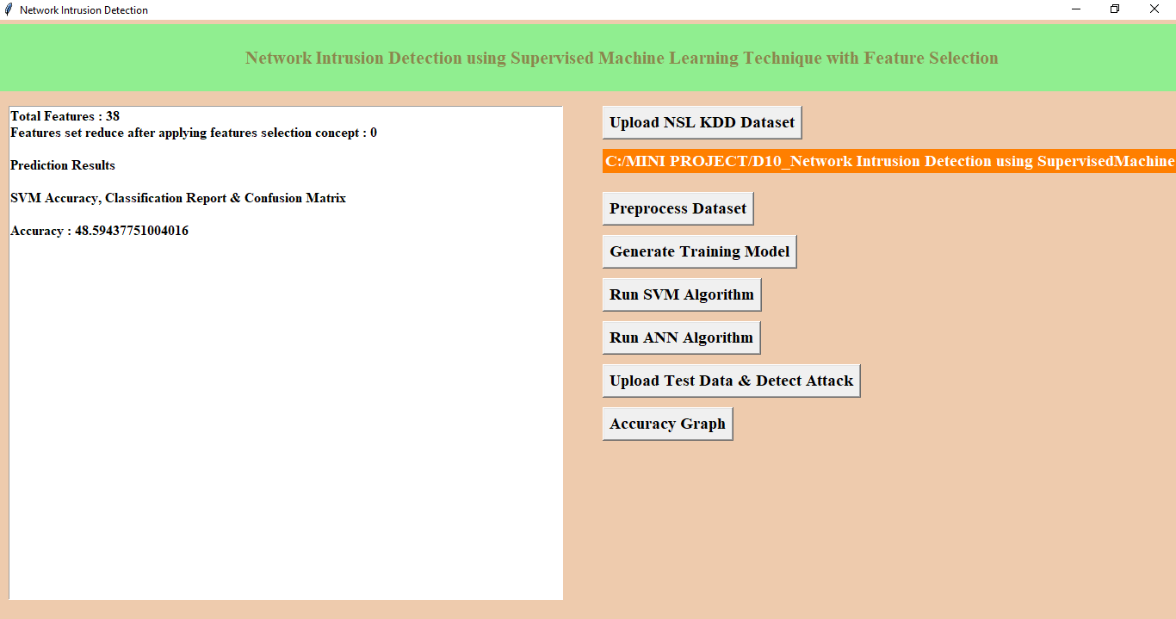
In above screen we can see with SVM we got 84.73% accuracy, now click on ‘Run ANN Algorithm’ to calculate ANN accuracy.

Slide 24
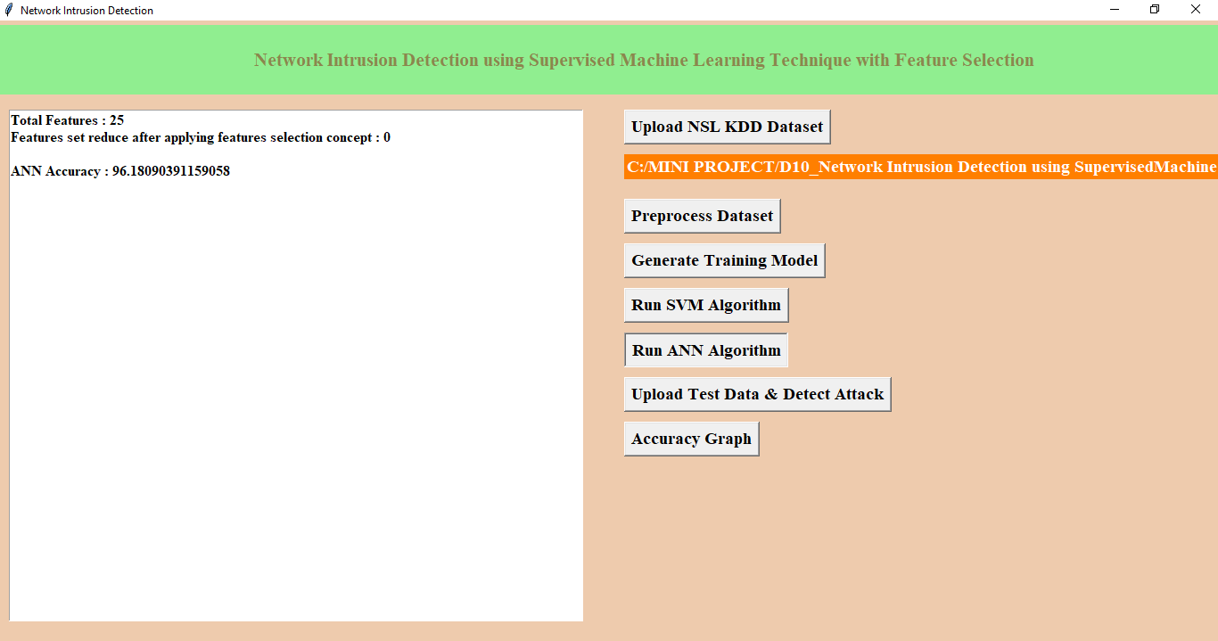
In above screen we got 96.18% accuracy, now we will click on ‘Upload Test Data & Detect Attack’ button to upload test data and to predict whether test data is normal or contains attack. All test data has no class either 0 or 1 and application will predict and give us result. See below some records from test data

Slide 25
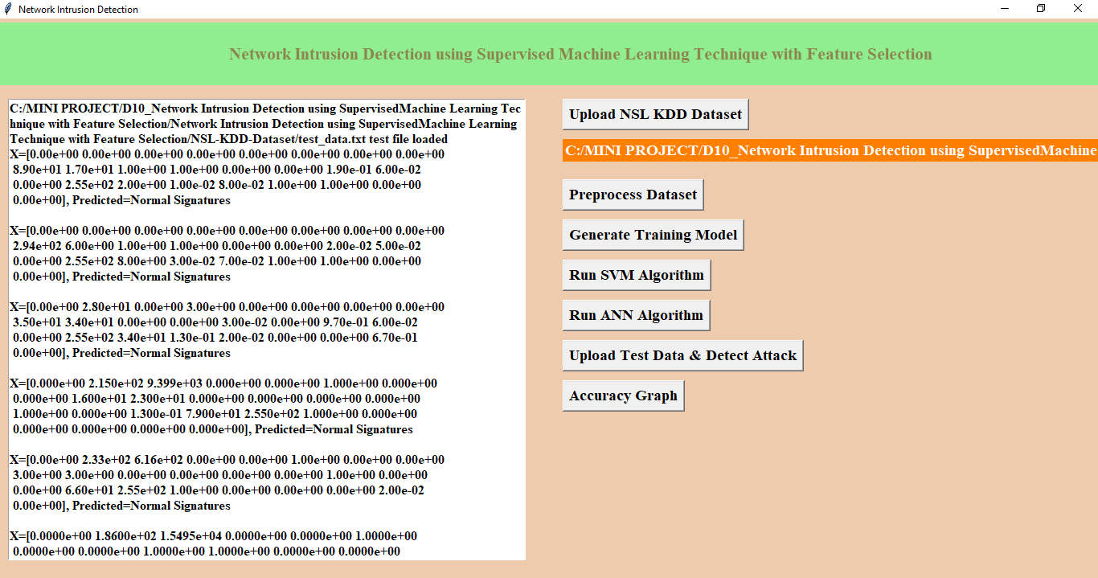
In above screen for each test data we got predicted results as ‘Normal Signatures’ or ‘infected’ record for each test record. Now click on ‘Accuracy Graph’ button to see SVM and ANN accuracy comparison in graph format

Slide 26
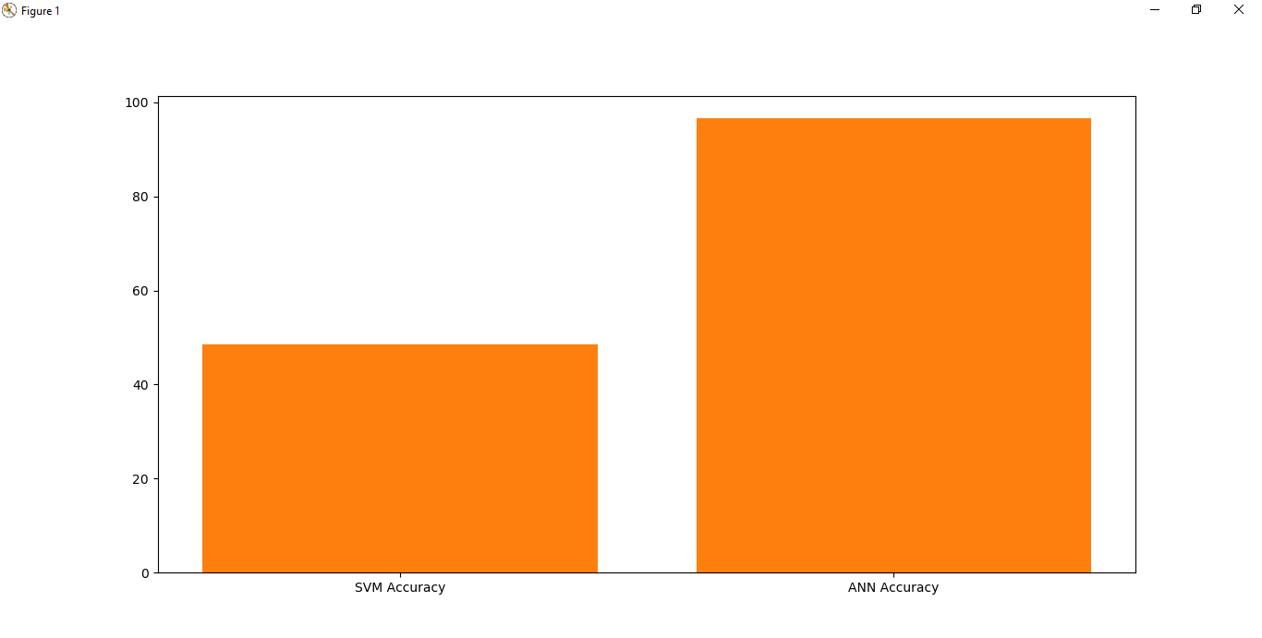
From above graph we can see ANN got better accuracy compare to SVM, in above graph x-axis contains algorithm name and y-axis represents accuracy of that algorithms .

Slide 27
Conclusion
We have concluded that different machine learning models using different machine learning algorithms and different feature selection methods to find a best model.
The analysis of the result shows that the model built using ANN and wrapper feature selection outperformed all other models in classifying network traffic correctly with detection rate of 96.18%
By this project we made a innvoaticve approach for detecting the network intrusion

Slide 28
Future Scope
In the future, instead of detecting an intruder, detection systems will identify a suspicious event and let the system administrator or security officer decide whether to start an investigation
Therefore, it is suggested that the models should be validated on all locations in the future. This ensures that the chosen model performs well on all locations. Another way in which the implementation of models can be improved is through the use of multiple evaluation metrics. In this study, the mean absolute error was used. To complement this, the use of metrics such as root mean squared error(RMSE), mean absolute percentage error (MAPE) or adjusted R-square are recommended. The addition of live data streams in combination with dynamic systems, would also allow for more accurate short-term predictions, accounting for unforeseen circumstances.These additions may lead to better model performance or improved insights regarding the traffic flow rate

Slide 29
References
H. Song, M. J. Lynch, and J. K. Cochran, “A macro-social exploratory analysis of the rate of interstate cybervictimization,” American Journal of Criminal Justice, vol. 41, no. three, pp. 583–601, 2016.
P. Alaei and F. Noorbehbahani, “Incremental anomaly- based intrusion detection system using limited labeled data,” in Web Research (ICWR), 2017 3th International Conference on, 2017, pp. 178–184.
Srinivas Mukkamala, Guadalupe Janoski, Andrew Sung Intrusion Detection: Support Vector Machines and Neural Networks.
Wei Li “Using Genetic Algorithm for NetworkIntrusion Detection.
Cheng, Tay, &Huang, 2012 “Online sequential extreme learning Machine”(OS-ELM).
Liu, Chen, Liao, & Zhang, “Intrusion detection techniques”

Slide 30
Thank you.

